Slide 1
Winsock2

Slide 2
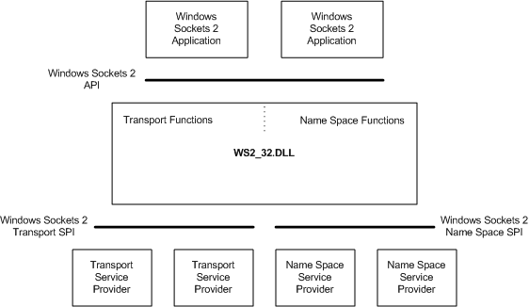
Windows Sockets 2 Architecture
Windows Sockets 2 architecture is compliant with the
Windows Open System Architecture (WOSA)
Winsock defines a standard service provider interface (SPI) between the application programming interface (API), with its functions exported from WS2_32.dll and the protocol stacks.

Slide 3
About Servers and Clients
There are two distinct types of socket network applications: Server and Client.
Servers and Clients have different behaviors; therefore, the process of creating them is different.

Slide 4
About Servers and Clients
Server
Initialize Winsock.
Create a socket.
Bind the socket.
Listen on the socket for a client.
Accept a connection from a client.
Receive and send data.
Disconnect.
Client
Initialize Winsock.
Create a socket.
Connect to the server.
Send and receive data.
Disconnect.

Slide 5
Creating a Basic Winsock Application
Ensure that the build environment links to the Winsock Library file Ws2_32.lib.
Applications that use Winsock must be linked with the Ws2_32.lib library file.
The #pragma comment indicates to the linker that the Ws2_32.lib file is needed.
Begin programming the Winsock application.
Use the Winsock API by including the Winsock 2 header files.
The Winsock2.h header file contains most of the Winsock functions, structures, and definitions.
The Ws2tcpip.h header file contains definitions introduced in the WinSock 2 Protocol-Specific Annex document for TCP/IP that includes newer functions and structures used to retrieve IP addresses.
#include <winsock2.h>
#include <ws2tcpip.h>
#include <stdio.h>
#pragma comment(lib, "Ws2_32.lib")
int main() {
return 0;
}

Slide 6
Why winsock2, not winsock1.1
Winsock2.h header file internally includes core elements from the Windows.h header file, so there is not usually an #include line for the Windows.h header file in Winsock applications.
If an #include line is needed for the Windows.h header file, this should be preceded with the
#define WIN32_LEAN_AND_MEAN macro.
#ifndef WIN32_LEAN_AND_MEAN
#define WIN32_LEAN_AND_MEAN
#endif
#include <windows.h>
#include <winsock2.h>
#include <ws2tcpip.h>
#include <iphlpapi.h>
#include <stdio.h>
#pragma comment(lib, "Ws2_32.lib")
int main() {
return 0;
}

Slide 7
Initializing Winsock
All processes (applications or DLLs) that call Winsock functions must initialize the use of the Windows Sockets DLL before making other Winsock functions calls. This also makes certain that Winsock is supported on the system.
Create a object called wsaData.
WSADATA wsaData;
2) Call and return its value as an integer and check for errors.
int iResult;
// Initialize Winsock
iResult = WSAStartup(MAKEWORD(2,2), &wsaData);
if (iResult != 0) {
printf("WSAStartup failed: %d\n", iResult);
return 1;
}
The WSAStartup function is called to initiate use of WS2_32.dll.
The structure contains information about the Windows Sockets implementation. The MAKEWORD(2,2) parameter of makes a request for version 2.2 of Winsock on the system, and sets the passed version as the highest version of Windows Sockets support that the caller can use.

Slide 8
Creating a socket for the client
After initialization, a SOCKET object must be instantiated for use by the client.
Declare an addrinfo object that contains a sockaddr structure and initialize these values.
For this application, the Internet address family is unspecified so that either an IPv6 or IPv4 address can be returned.
The application requests the socket type to be a stream socket for the TCP protocol.
struct addrinfo *result = NULL,
*ptr = NULL,
hints;
ZeroMemory( &hints, sizeof(hints) );
hints.ai_family = AF_UNSPEC;
hints.ai_socktype = SOCK_STREAM;
hints.ai_protocol = IPPROTO_TCP;

Slide 9
Creating a socket for the client
Call the getaddrinfo function requesting the IP address for the server name passed on the command line.
The TCP port on the server that the client will connect to is defined by DEFAULT_PORT as 27015 in this sample.
The getaddrinfo function returns its value as an integer that is checked for errors.
#define DEFAULT_PORT "27015"
// Resolve the server address and port
iResult = getaddrinfo(argv[1], DEFAULT_PORT, &hints, &result);
if (iResult != 0) {
printf("getaddrinfo failed: %d\n", iResult);
WSACleanup();
return 1;
}

Slide 10
Creating a socket for the client.
Create a SOCKET object called ConnectSocket.
SOCKET ConnectSocket = INVALID_SOCKET;

Slide 11
Creating a socket for the client.
Call the socketgetaddrinfo function and return its value to the ConnectSocket variable.
For this application, use the first IP address returned by the call to that matched the address family, socket type, and protocol specified in the hints parameter.
In this example,
A TCP stream socket was specified with a socket type of SOCK_STREAM and a protocol of IPPROTO_TCP.
The address family was left unspecified (AF_UNSPEC), so the returned IP address could be either an IPv6 or IPv4 address for the server.
If the client application wants to connect using only IPv6 or IPv4, then the address family needs to be set to AF_INET6 for IPv6 or AF_INET for IPv4 in the hints parameter.
// Attempt to connect to the first address returned by
// the call to getaddrinfo
ptr=result;
// Create a SOCKET for connecting to server
ConnectSocket = socket(ptr->ai_family, ptr->ai_socktype, ptr->ai_protocol);

Slide 12
Creating a socket for the client.
Check for errors to ensure that the socket is a valid socket.
if (ConnectSocket == INVALID_SOCKET) {
printf("Error at socket(): %ld\n", WSAGetLastError());
freeaddrinfo(result);
WSACleanup();
return 1;
}
The parameters passed to the socket function can be changed for different implementations.
Error detection is a key part of successful networking code.
If the call fails, it returns INVALID_SOCKET.
The if statement in the previous code is used to catch any errors that may have occurred while creating the socket. WSAGetLastError() returns an error number associated with the last error that occurred.
WSACleanup is used to terminate the use of the WS2_32 DLL.

Slide 13
Connecting to a socket
For a client to communicate on a network, it must connect to a server.
Call the connectsockaddr function, passing the created socket and the structure as parameters.
Check for general errors.
// Connect to server.
iResult = connect( ConnectSocket, ptr->ai_addr, (int)ptr->ai_addrlen);
if (iResult == SOCKET_ERROR) {
closesocket(ConnectSocket);
ConnectSocket = INVALID_SOCKET;
}
// Should really try the next address returned by getaddrinfo
// if the connect call failed
// But for this simple example we just free the resources
// returned by getaddrinfo and print an error message
freeaddrinfo(result);
if (ConnectSocket == INVALID_SOCKET) {
printf("Unable to connect to server!\n");
WSACleanup();
return 1;
}
The getaddrinfo function is used to determine the values in the sockaddr structure.
In this example, the first IP address returned by the getaddrinfo function is used to specify the sockaddr structure passed to the connect.
If the connect call fails to the first IP address, then try the next addrinfo structure in the linked list returned from the getaddrinfo function.
The information specified in the sockaddr structure includes:
IP address of the server that the client will try to connect to.the port number on the server that the client will connect to.
2) This port was specified as port 27015 when the client called the function.

Slide 14
Sending and Receiving Data on the Client
send and recv functions used by the client once a connection is established.
// shutdown the connection for sending since no more data will be sent
// the client can still use the ConnectSocket for receiving data
iResult = shutdown(ConnectSocket, SD_SEND);
if (iResult == SOCKET_ERROR) {
printf("shutdown failed: %d\n", WSAGetLastError());
closesocket(ConnectSocket);
WSACleanup();
return 1;
}
// Receive data until the server closes the connection
do {
iResult = recv(ConnectSocket, recvbuf, recvbuflen, 0);
if (iResult > 0)
printf("Bytes received: %d\n", iResult);
else if (iResult == 0)
printf("Connection closed\n");
else
printf("recv failed: %d\n", WSAGetLastError());
} while (iResult > 0);
#define DEFAULT_BUFLEN 512
int recvbuflen = DEFAULT_BUFLEN;
const char *sendbuf = "this is a test";
char recvbuf[DEFAULT_BUFLEN];
int iResult;
// Send an initial buffer
iResult = send(ConnectSocket, sendbuf, (int) strlen(sendbuf), 0);
if (iResult == SOCKET_ERROR) {
printf("send failed: %d\n", WSAGetLastError());
closesocket(ConnectSocket);
WSACleanup();
return 1;
}
printf("Bytes Sent: %ld\n", iResult);
The send and recv functions both return an integer value of the number of bytes sent or received, respectively, or an error.
Each function also takes the same parameters: the active socket, a char buffer, the number of bytes to send or receive, and any flags to use.

Slide 15
Disconnecting the Client
Once the client is completed sending and receiving data, the client disconnects from the server and shutdowns the socket.
To disconnect and shutdown a socket
When the client is done sending data to the server, the shutdown function can be called specifying SD_SEND to shutdown the sending side of the socket.
This allows the server to release some of the resources for this socket.
The client application can still receive data on the socket.
// shutdown the send half of the connection since no more data will be sent
iResult = shutdown(ConnectSocket, SD_SEND);
if (iResult == SOCKET_ERROR) {
printf("shutdown failed: %d\n", WSAGetLastError());
closesocket(ConnectSocket);
WSACleanup();
return 1;
}

Slide 16
Multiplexing
Poll
–fcntl
Ioctlsocket
select(), poll(), and epoll() — all of which are I/O multiplexing mechanisms used to monitor multiple file descriptors (like sockets) to see if they're ready for I/O (read/write).

Slide 17
Disconnecting the client
When the client application is done receiving data, the closesocket function is called to close the socket.
When the client application is completed using the Windows Sockets DLL, the WSACleanup function is called to release resources.
// cleanup
closesocket(ConnectSocket);
WSACleanup();
return 0;

Slide 18
Secure Winsock programming

Slide 19
Secure Winsock Programming
Communications using sockets can also be encrypted using the SSL/TLS standards using Secure Channel, also known as Schannel technology.
Schannel is a security support provider (SSP) that contains a set of security protocols that provide identity authentication and secure, private communication through encryption.
Schannel is primarily used for Internet applications that require secure Hypertext Transfer Protocol (HTTP) communications.
Secure Winsock programming means using the Windows Sockets API (Winsock) to send and receive data over the network with encryption and authentication, so that data is safe from hackers or unauthorized access.

Slide 20
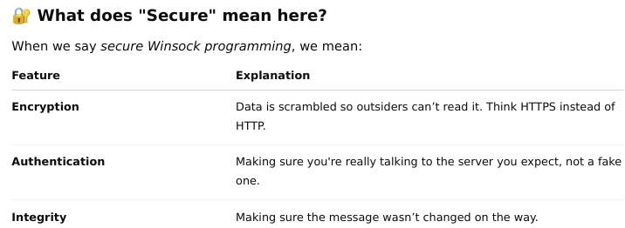
🧱 What is Winsock?
Winsock is like a toolbox in Windows for making programs talk to each other over a network (like websites, chat apps, etc.).

Slide 21
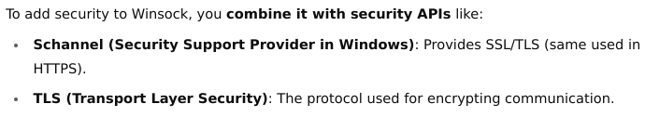
✅ How do you make Winsock secure?

Slide 22
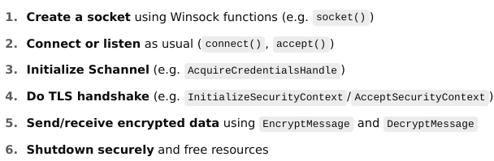
Basic Steps for Secure Winsock

Slide 23
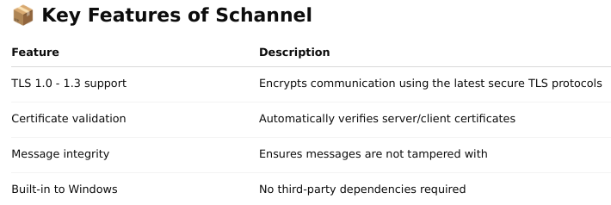
What Is Schannel?
Schannel (short for Secure Channel) is a Windows Security Support Provider (SSP) that implements the SSL/TLS protocols. It's used to provide authentication, encryption, and message integrity for secure communication between applications over the network.
It’s part of the Security Support Provider Interface (SSPI) in Windows, a framework similar to GSSAPI on Unix/Linux.
✅ Schannel allows you to use TLS/SSL without needing to implement crypto yourself. It handles the handshake, certificate validation, encryption/decryption, etc.

Slide 24
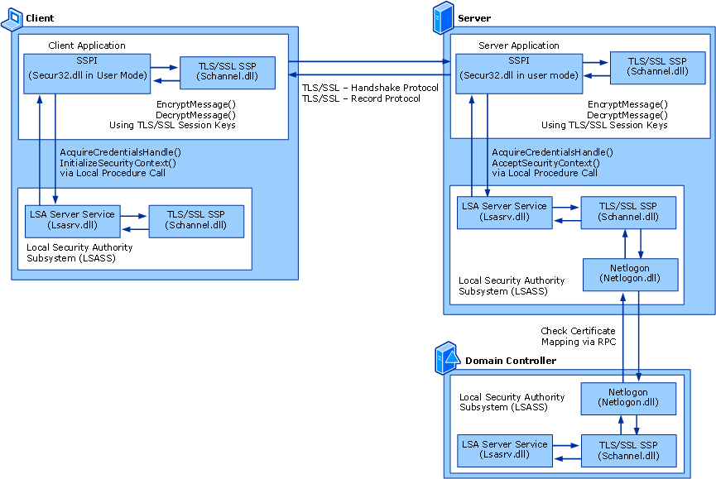

Slide 25
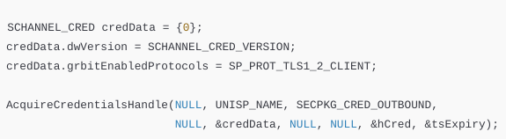
Typical Schannel TLS Flow
1. Acquire Credentials
Use AcquireCredentialsHandle() to get a CredHandle. This contains TLS version and certificate info.

Slide 26
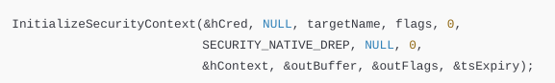
Typical Schannel TLS Flow
2. Perform TLS Handshake
You use InitializeSecurityContext() to start a handshake.
Each call produces an outgoing TLS message (like ClientHello), and expects a response from the server (like ServerHello). You keep looping until the handshake completes.
🌀 This handshake loop continues:
Send Schannel output to the server
Receive server reply
Call InitializeSecurityContext() again with input
Once SEC_E_OK is returned, handshake is complete!

Slide 27
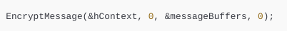
Typical Schannel TLS Flow
3. Encrypt and Send Data
Use EncryptMessage() to encrypt the data before sending over the socket.
The output is sent over the socket. The remote party will decrypt it.

Slide 28
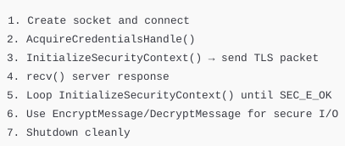
Typical Schannel TLS Flow
4. Receive and Decrypt Data
Use DecryptMessage() to process incoming TLS-encrypted messages from the server.
This gives you back the plaintext content.
Summary
5. Shutdown Securely
Use ApplyControlToken() and DeleteSecurityContext() to close the session gracefully.

Slide 29
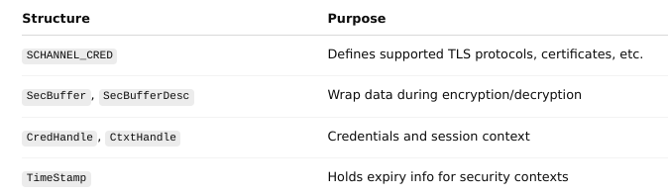
Important Schannel Structures

Slide 30
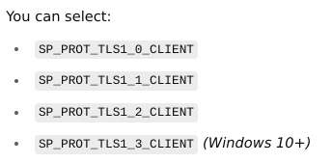
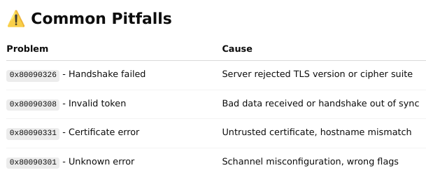
Protocol & Version Support

Slide 31
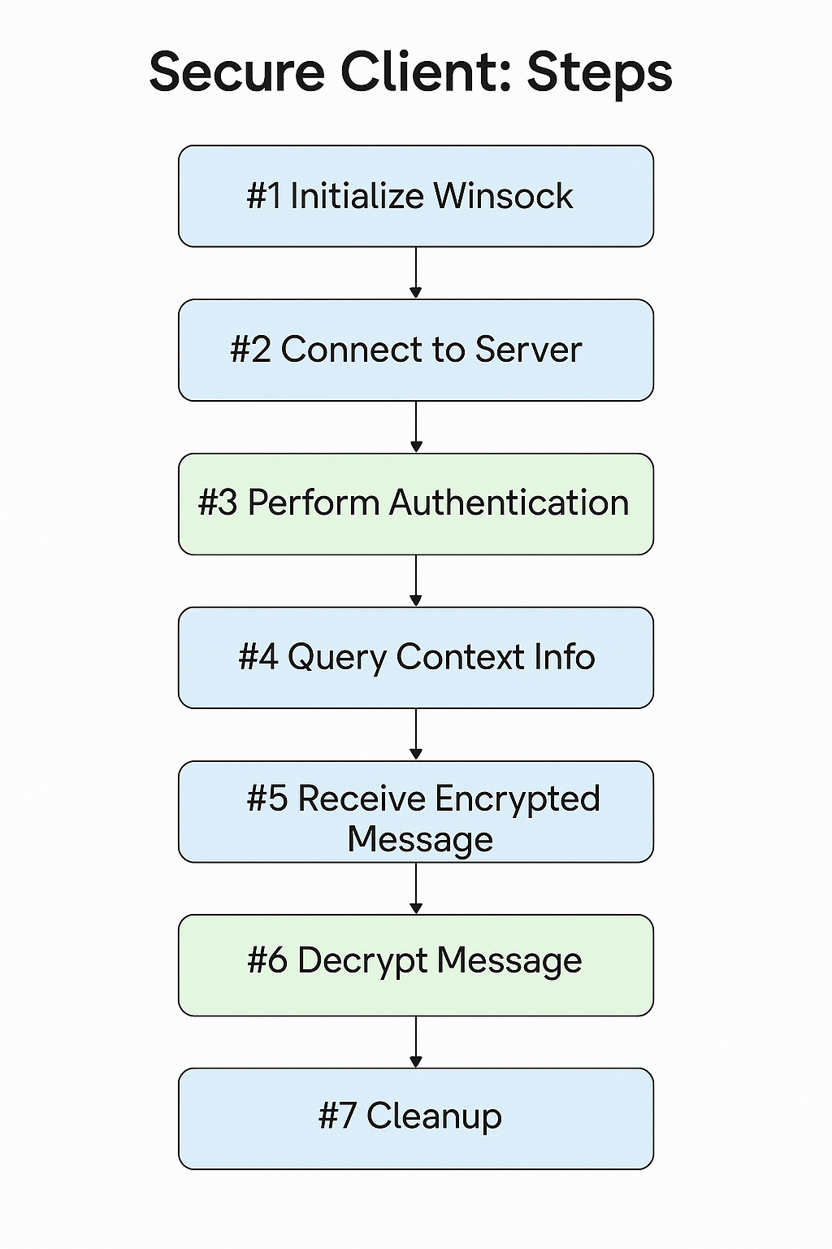
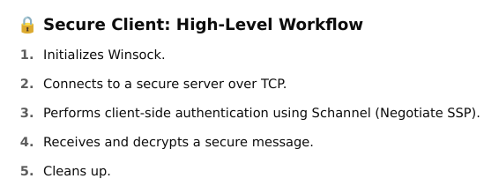
Schannel-client

Slide 32
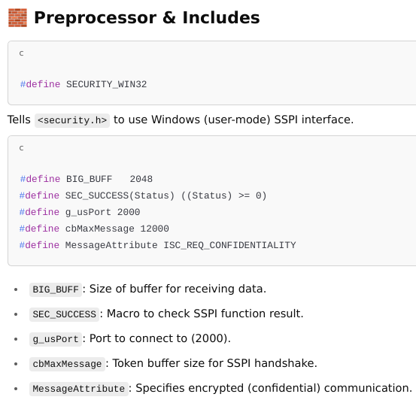
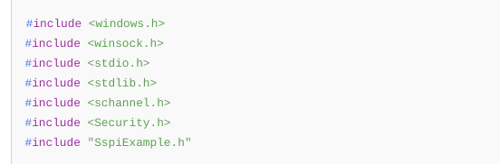

Slide 33
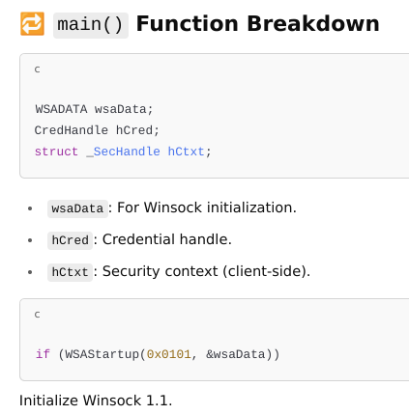
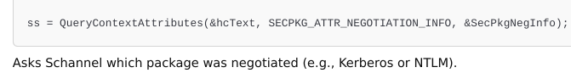
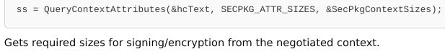
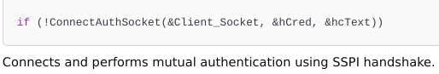

Slide 34
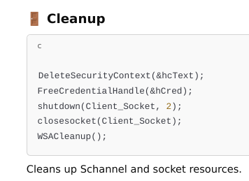
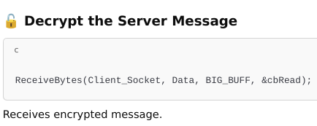
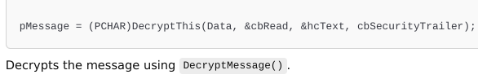
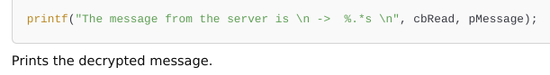

Slide 35
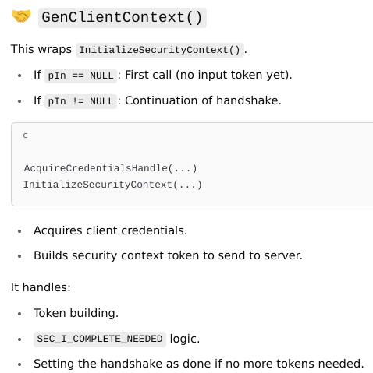
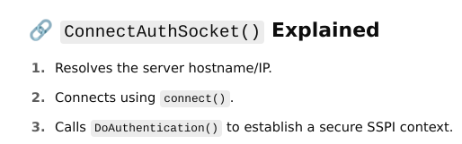
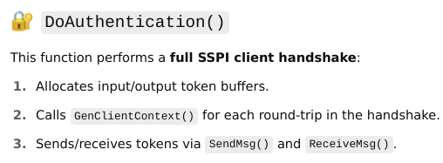
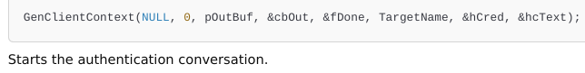

Slide 36
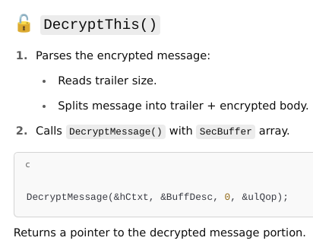
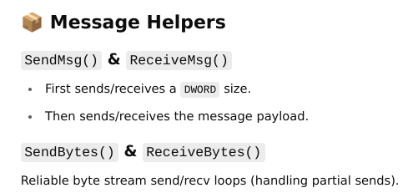
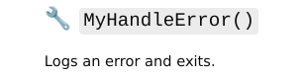
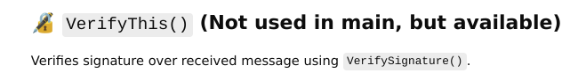

Slide 37
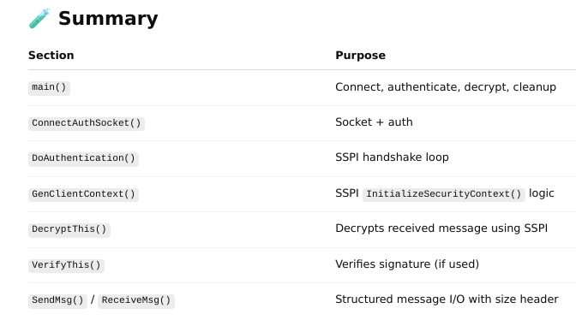
Flow

Slide 38
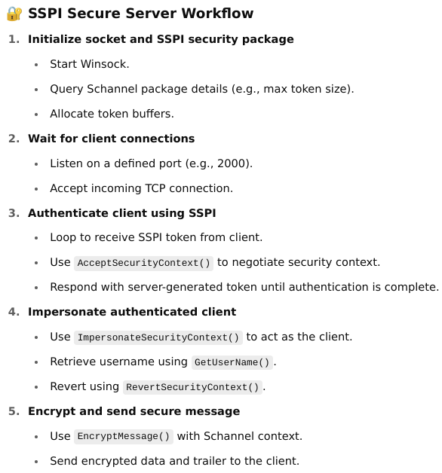
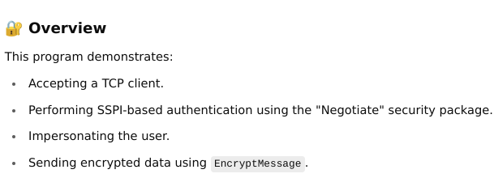
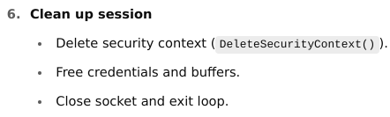
Schannel_Server.c

Slide 39
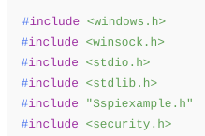
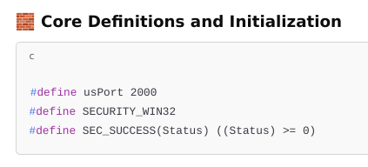
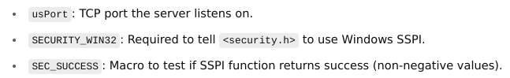

Slide 40
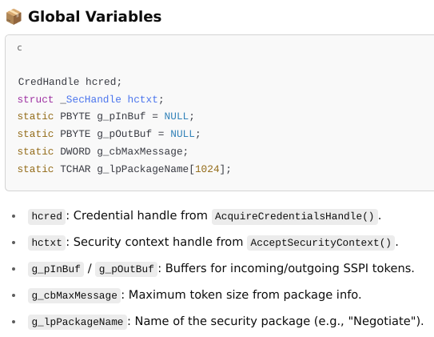

Slide 41
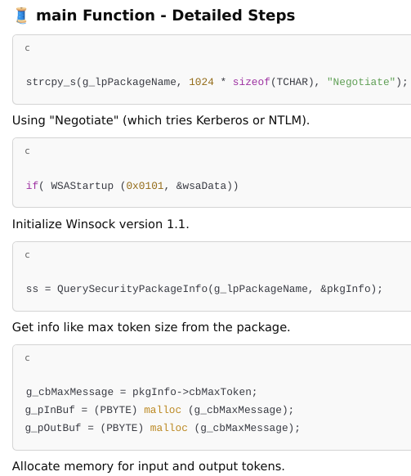
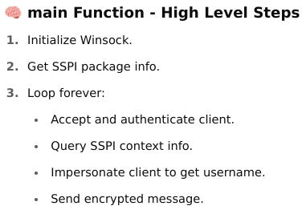

Slide 42
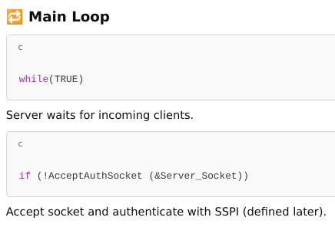
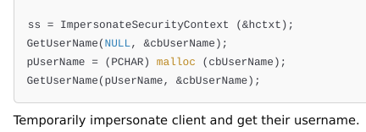
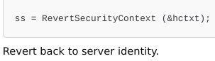
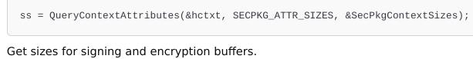

Slide 43
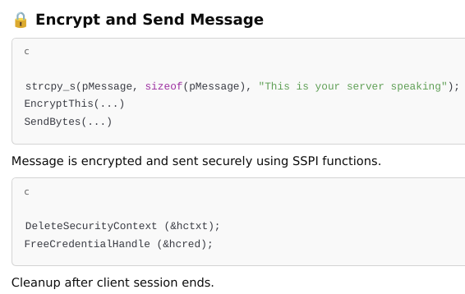
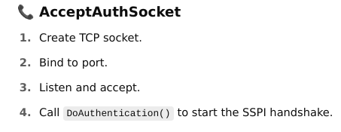

Slide 44
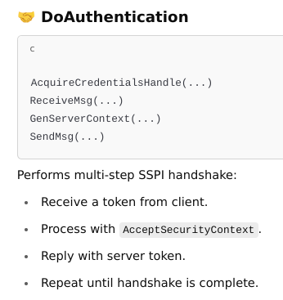



Slide 45

Flow

Slide 46


Slide 47


Slide 48


Slide 49



Slide 50


Slide 51


Slide 52


Threads - Multithreading

Slide 53


